Slide 1
Key Club 101
Region Training Conference 2019
Name, Position
Notes:
Membership Recruitment by _____________________________

Slide 2
The Big Question:
“Do we make KEYS or something?”
(Short Answer: we really don’t)

Slide 3
Mission: Key Club is an international, student-led organization providing its members with opportunities to perform service, build character, and develop leadership.
Vision: We are caring and competent servant-leaders transforming communities world-wide.

Slide 4
Key Club History
Key Club was started by Albert C. Olney and Frank C. Vincent on May 7, 1925 at Sacramento High School in Sacramento, CA, which still exists as a Key Club today.
They approached a neighboring Kiwanis club to help charter a similar club for service at their high school.

Slide 5
The club was comprised of the key boys in the school, willing to serve the school in any way possible and to create better school spirit– hence the name Key Club
In 1943, Key Club reached international status and Malcolm Lewis became the first president

Slide 6
Motto, Core Values, & Colors
Motto: “CARING – Our way of life”
Core Values
Caring
Character Building
Inclusiveness
Leadership
Key Club Colors
Blue – Unwavering Character
White – Purity
Gold – Service

Slide 7
Key Club Pledge
“I pledge on my honor to uphold the objects of Key Club International; to build my home, school and community; to serve my nation and the world; and combat all forces which tend to undermine these institutions.”

Slide 8
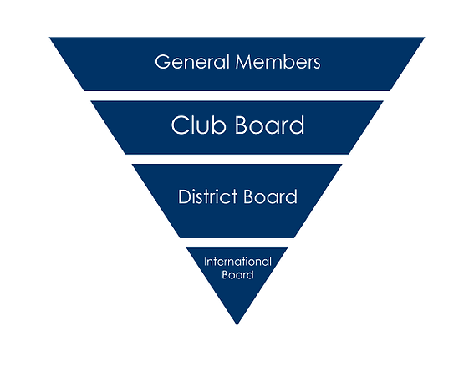
Key Club Structure
It starts with YOU!
Members make up a club.
A board is elected/appointed based on Club Bylaws that are updated/signed at the beginning of every year.
Multiple clubs make up a division.
Multiple divisions make up a region.
The regions make up a district.

Slide 9
Club Officers
Presidents
Vice Presidents
Secretaries
Treasurers
Editors
* Public Relations
* Class Representatives
* Committee Chairs
* Aren’t considered Club Officers, but serve on the Board of Directors; appointed positions

Slide 10
Division Structure
A cluster of anywhere 1-15 clubs make up a Division.
Divisions are numbered according to the divisions of the founding Kiwanis Clubs in the area.
One Lt. Governor is elected between January and February and serves the division as a liaison between the clubs and the District.

Slide 11
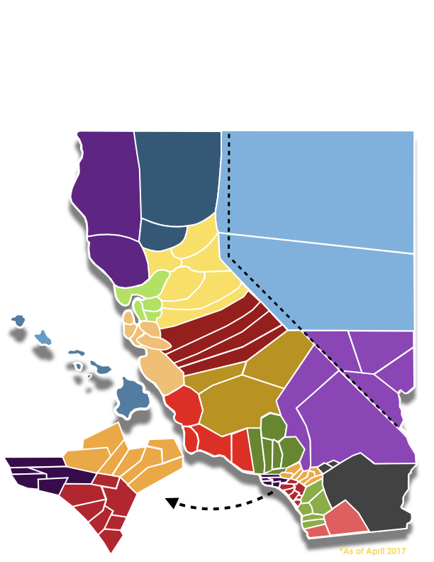
Region Structure
A cluster from anywhere from 1-7 Divisions make up a region.
A Region Advisor mentors and guides the Lt. Governors within the Region.

Slide 12
District Structure
In the California-Nevada-Hawaii District:
+41,500 members
+700 clubs
77 divisions
18 regions

Slide 13
District Executives
Serving the District:
District Governor: Chuofan Yu
District Secretary: Lawrence Guittap
District Treasurer: Kristie Poon

Slide 14
Appointed Board Members
District News Editor: Jenny Chen
District Tech Editor: Archishma Kavalipati
Communications & Marketing Chair: Nathan Banlusak
District Convention Chair: Minah Yang
Kiwanis Family and Foundation Chair: Brandon Ma
Member Recognition Chair: Annaleigh Nguyen
Member Development and Education Chair: Christopher Kao
Policy, International Business, & Elections Chair: Rita Nguyen
Service Projects Chair: Lily Marshall

Slide 15
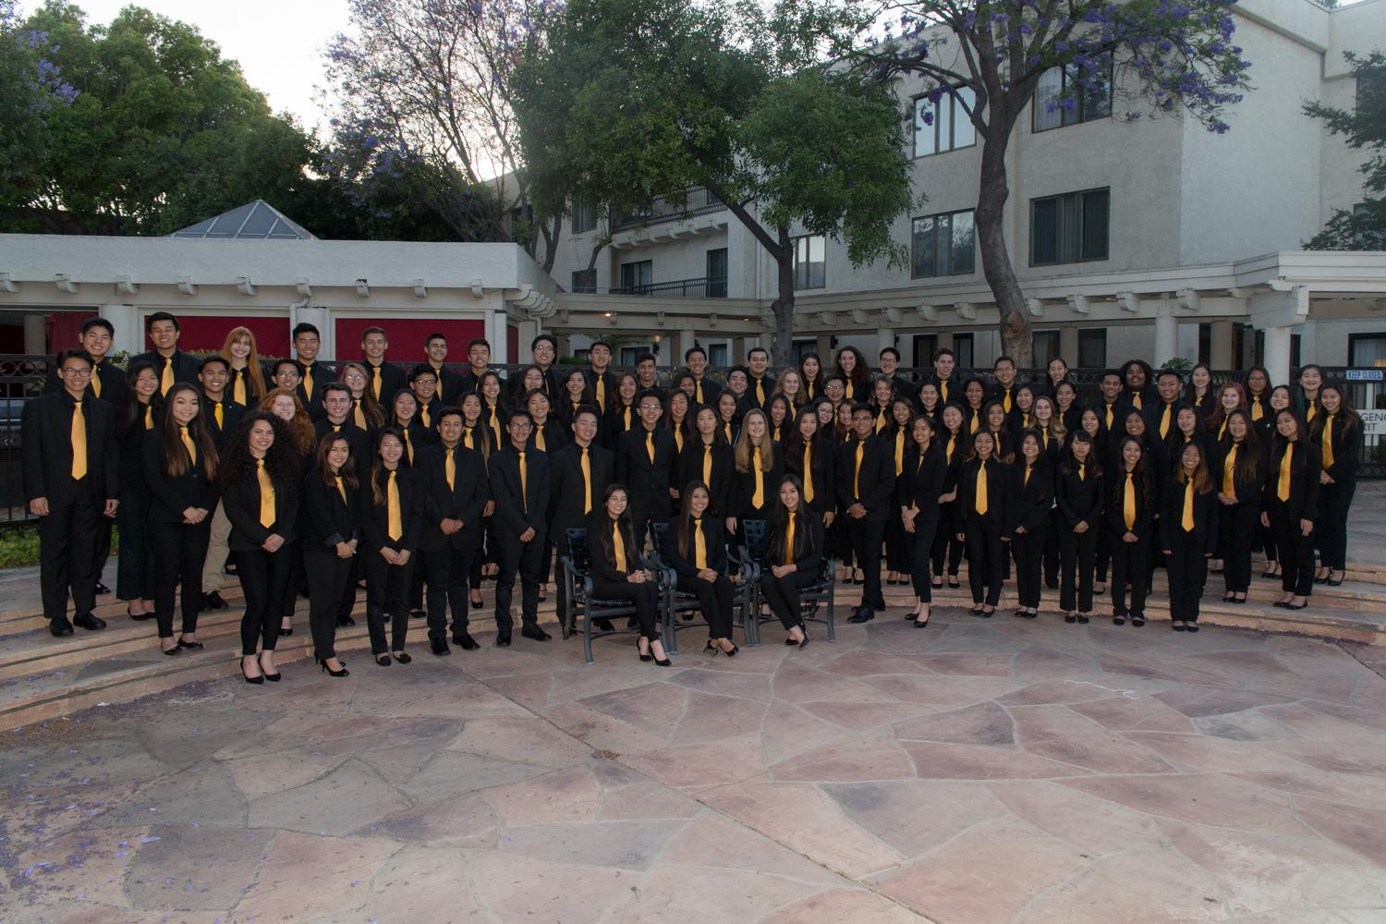
District Board
Lt. Governors from 75 Divisions within CNH
Appointed Board Members
District Executives

Slide 16
Key Club International
33 Districts make up Key Club International.
The International Council is made up of the International President, International Vice President, 11 International Trustees, and 33 District Governors.
The International Board is made up of the International President, International Vice President, and 11 International Trustees

Slide 17
Together, We Are…
276,000+ Members
5,000+ Clubs
33 Districts
38 Countries
1 Organization

Slide 18
Common Acronyms
CNH: California – Nevada - Hawaii
DCM: Division Council Meeting held by the LtG
DCON: District Convention
DGOV: District Governor
KFF: Kiwanis Family and Foundation
LTG: Lieutenant Governor
MR: Member Recognition
MRF: Monthly Report Form completed by club secretaries
MRS: Member Relations
OTC: Officer Training Conference for club officers and members within a division
PIE: Policies, International Business, and Elections
RTC: Region Training Conference for Key Club members within a region

Slide 19
Key Club Cheer
HOW DO YOU FEEL?
I feel good! Oh, I feel so good!
UNGH! (pelvic thrust)
I feel fine! All of the time!
Abooga! Abooga!
Abooga! Booga! Booga!
Vegas Key Club members substitute “ABOOGA” for “UNGA”
CNH Mascot: Bee

Slide 20
CNH Key Club District Rap
FROM THE EAST TO THE WEST!
YOU KNOW WE’RE THE BEST!
WE’RE THE DISTRICT WITH THE STING!
AND THAT’S WHY WE SING!
WE’RE THE BEES! BUZZ! BUZZ!
WE’RE THE BEES! BUZZ! BUZZ!
IT’S ALL ABOUT THE PARTY HARDY!
CNH BEES!

Slide 21
Questions?
Comments?
Concerns?

Slide 22
Acknowledgements
The CNH Key Club District would like to acknowledge the following individuals who have contributed to this presentation over the years.
Minghua Ong, Member Relations Committee Chair, 2016-2017
Katherine Luza, Division 13 South Lt. Governor, 2017-2018
Johnny Chen, Member Relations Committee Chair, 2017-2018
Christopher Kao, Membership Development & Education Chair, 2018-2019
Daniel Chong, Membership Development & Education Chair, 2019-2020

