Slide 1
CyberKey
Region Training Conference 2019
Name, Position

Slide 2
Overview: Web
How to effectively use the CNH CyberKey
Tabs
Frequently Used
Event promotion
Notes:
Why is support important?

Slide 3
What is the CyberKey?
The CyberKey is the official website of the California-Nevada-Hawaii District.
It is also one of the more frequently-used platforms to share information with members.
Notes:
Why is support important?

Slide 4
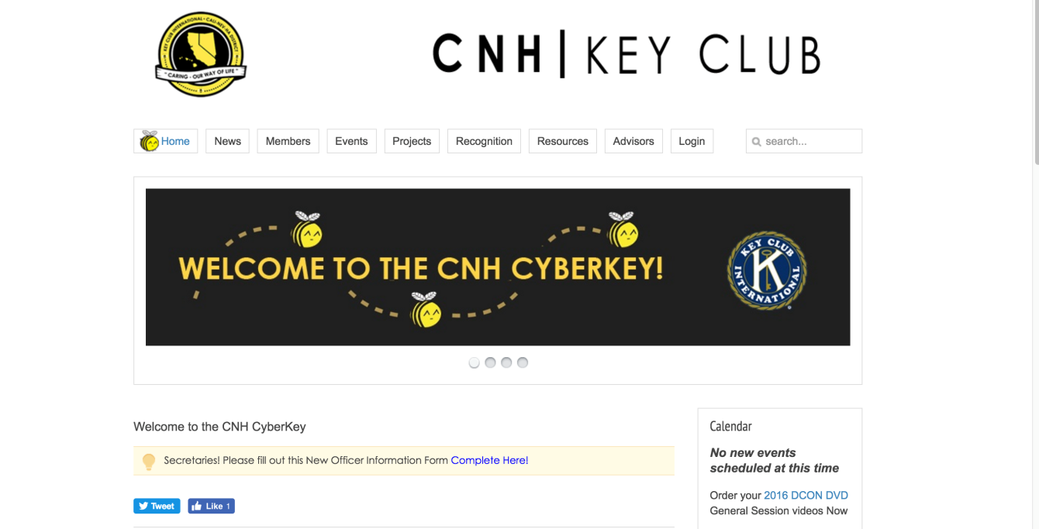
Use of the CyberKey
Main hub for members to access all CNH resources and updates
Notes:
Why is support important?

Slide 5
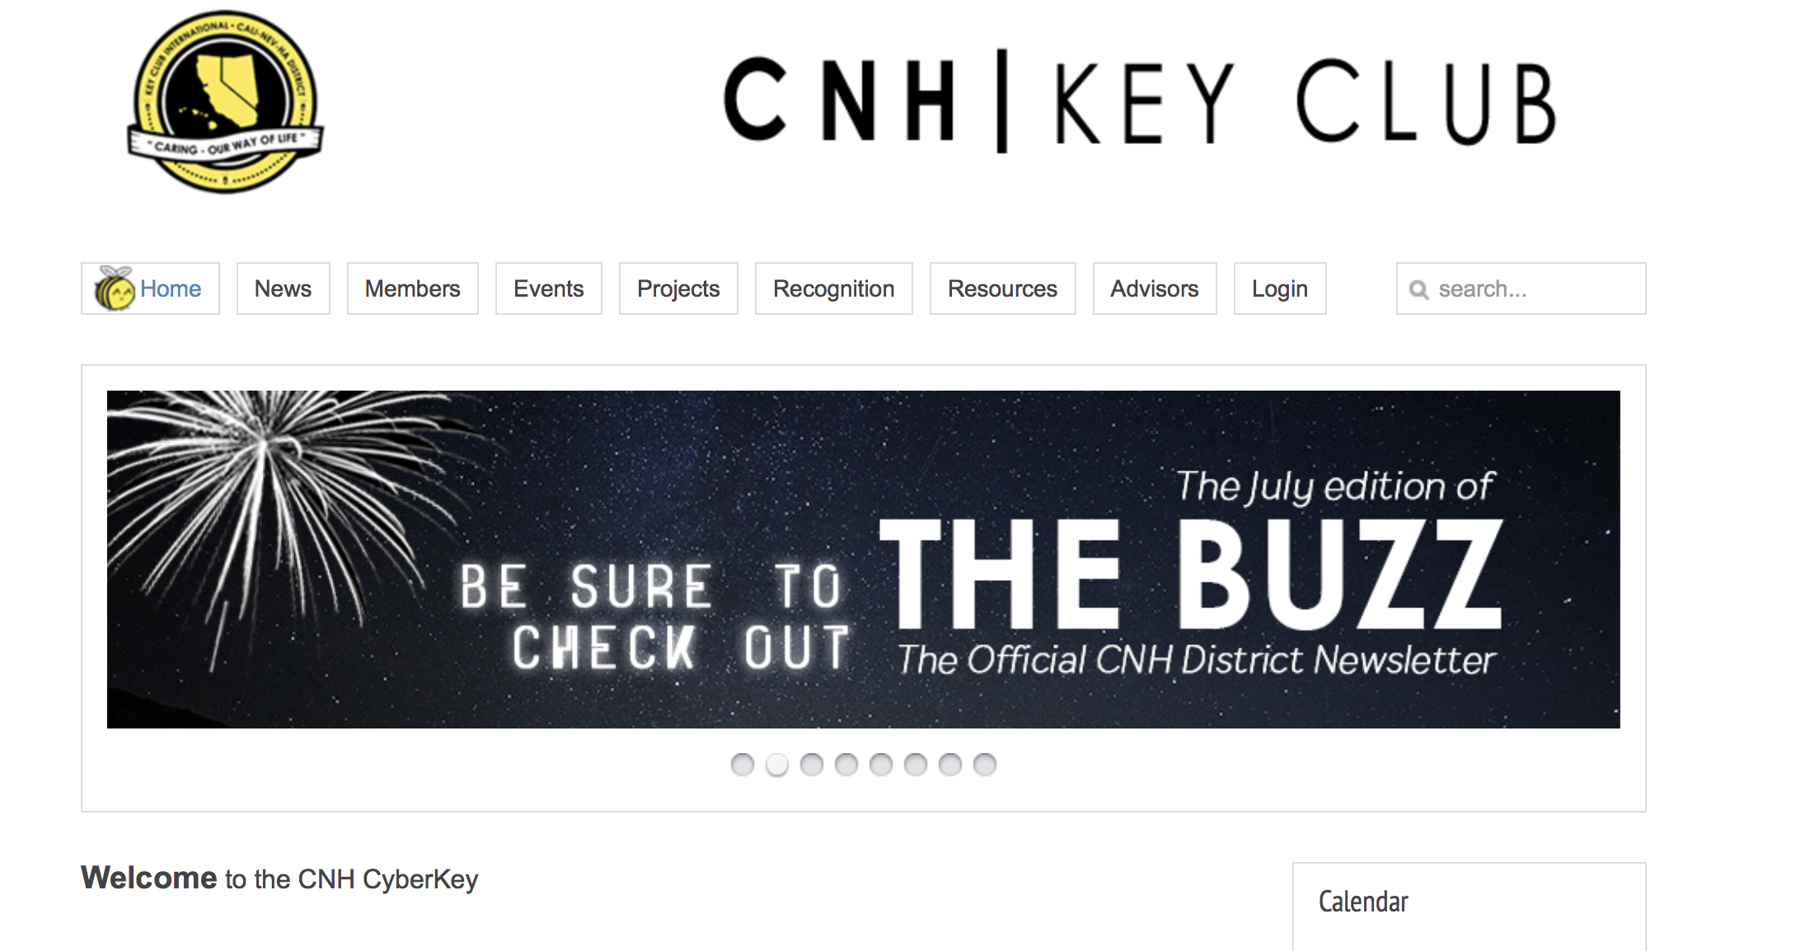
Banners
Banners on the homepage are used to give the most recent and/or important updates!
Notes:
Why is support important?

Slide 6
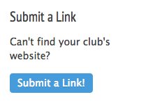
Divisions Page
Links to division and club websites
Encourage clubs to submit a link!
Notes:
Why is support important?

Slide 7
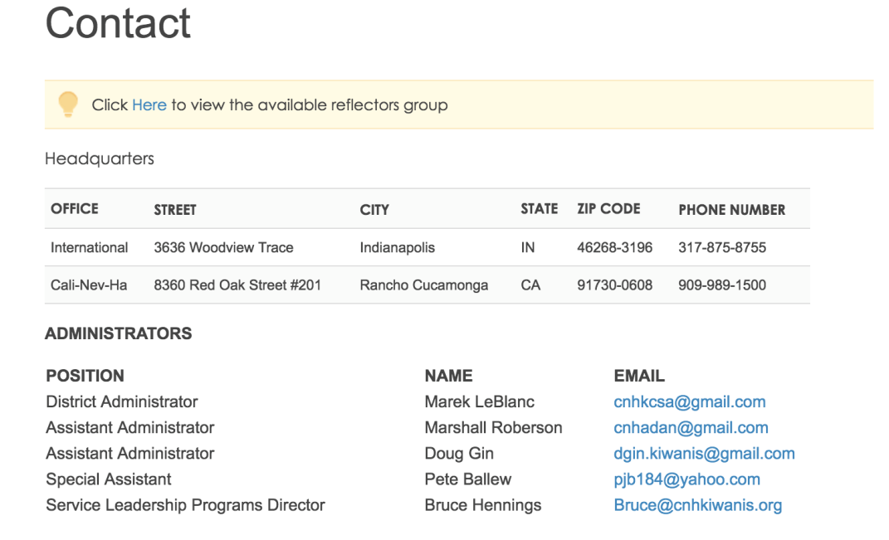
Contact Page
Information of LTG, District Leaders, and Region Advisors
Contact DTE if information is wrong

Slide 8
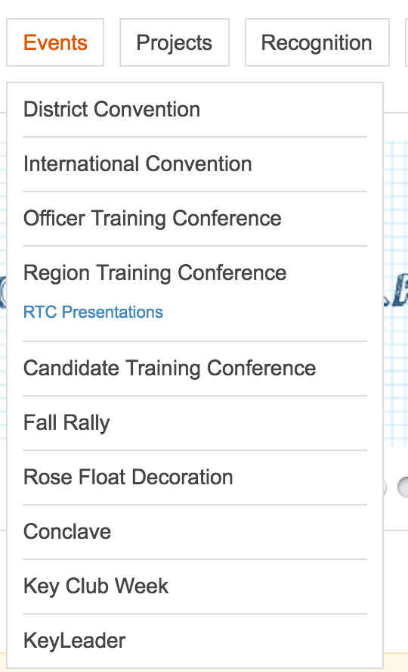
Events Tab
Convention, Fall Rallies, Training Conferences, etc.
Workshop materials
Schedule for events

Slide 9
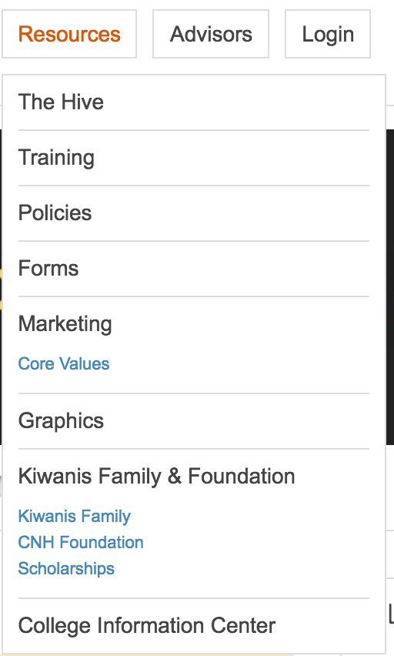
Resources Tab
Manuals, forms, and guides for clubs
Kiwanis Family and Foundation scholarships
Resources for advisors
Graphics Library

Slide 10
Event Promotion
Maintain Graphics Standards
Branding is KEY
Use BEE Graphics and CNH approved colors when promoting the CNH District
CyberKey Request form

Slide 11
Additional Information
Spot an error? Tell the DTE ASAP!
cnhkc.dte@gmail.com
Encourage others to use the resources found on the CyberKey

Slide 12
?
?
Questions?
Comments?
Concerns?
Go for it!

Slide 13
Acknowledgements
The CNH Key Club District would like to acknowledge the following individuals who have contributed to this presentation over the years.
Deidra Dilworth, District Tech Editor, 2016–2017
Roland Del Mundo, District Tech Editor, 2017-2018
Nathaniel Banlusak, Communication and Marketing Committee Chair, 2018-2019
Daniel Chong, Membership Development & Education Committee Chair, 2019-2020

