Slide 1
Fundraising
Region Training Conference 2019
Kenny Lam, D13S Executive Assistant
Cindy Nguyen, D19N Fundraising Coordinator
Sarah Blosser, D19N Merchandise Coordinator
Notes:
Membership Recruitment by _____________________________

Slide 2
Why Fundraise?
For charities (March of Dimes, PTP, etc.)
To save lives!
To lower expenses for things like RTC and FRS!
To make an impact on your community
To increase involvement in the club you serve
It’s fun!!
FUNdraise

Slide 3
Explaining Your Purpose
Create Posters and Social Media Flyers explaining what you are fundraising for
Preferred Charities, PTP, Eliminate Project, lowering costs for membership dues, DCON
Show the progress that has already been made
Educate the members of the importance of fundraising
Have your membership ID with you

Slide 4
Key Club Partner Service Partners
Pediatric Trauma Program
Children’s Miracle Network
March of Dimes
UNICEF – The Eliminate Project

Slide 5
Planning
Plan events at least 3 weeks in advance (more depending on the event)
Work together with the officers to brainstorm ideas for a fundraiser
Ex: Food, Project, Auction, Talent Show
Figure out the logistics of your fundraiser (What, when, where, how, why)
Set a realistic goal
Create a budget

Slide 6
Submit ALL necessary school and Key Club paperwork and wait for approval before advertising
ADVERTISE, ADVERTISE, ADVERTISE!
Don’t forget to have a back up plan!
Have fun!
Make sure you have an estimate on attendance!
“Fun”draising should not feel like a chore, it should be FUN!

Slide 7
Ideas – Club Level
Sell club merchandise
Bake Off
Movie Night
Roller or Ice Skating Night
Kiwanis Takeover Meetings
Garage Sales
Karaoke Night
Bowling Night
Sell Snacks & Drinks
Restaurant Fundraisers
Participate in School Activities
Holiday Grams

Slide 8
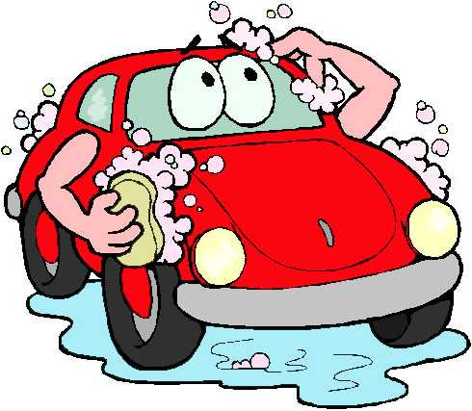
Ideas – Division Level
Sell Division merchandise
Awake-a-thon
Beauty Pageant
Host a Dance or Charity Ball
Restaurant Fundraiser
Sport Tournaments
Pie Social (Pie to Eliminate, Pie for PTP)
Talent Shows

Slide 9
Advertising is VERY important!
Without advertising the event, how will members know about the wonderful event you are planning?
Make posters
Google Groups
Social Network Sites (Facebook, Instagram)
Make a video
E-mail
Invite people personally
Print flyers
Announce at meetings

Slide 10
Questions?
Comments?
Concerns?

Slide 11
Acknowledgements
The CNH Key Club District would like to acknowledge the following individuals who have contributed to this presentation over the years.
Jacklyn Vo, Division 12 South Lt. Governor 2016-2017
Katherine Luza, Division 13 South Lt. Governor, 2017-2018
Johnny Chen, Member Relations Committee Chair 2017-2018
Hanna Von, Division 10 North Lieutenant Governor, 2018-2019
Ryan Lieng, Division 21 Lieutenant Governor, 2018-2019
Daniel Chong, Division 28 North Lieutenant Governor, 2018-2019
Christopher Kao, Membership Development & Education Chair, 2018-2019
Daniel Chong, Membership Development and Education Chair, 2019-2020

