Slide 1
Club Bylaws 101
Region Training Conference 2019
Name, Division
Notes:
Membership Recruitment by _____________________________

Slide 2
Introduction to Club Bylaws
What Are They?
A set of rules that help run the club
Can be anything from officer tasks to the set of graduation requirements
Created by the Board of Directors
Who are the Board of Directors?
Elected Club Officers (President, VP’s, Secretary, etc.)
Board can change bylaws to fit the needs of the club, as long as they follow the International and District Bylaws (can be found online)

Slide 3
Importance of Club Bylaws
Provide structure to the club itself
Gives guidelines to how the club shall run
can be used by new officers for advice
can help incoming members learn more about the club itself
Supports the club when officers are in need of assistance
dues process, elections, committees, etc.

Slide 4
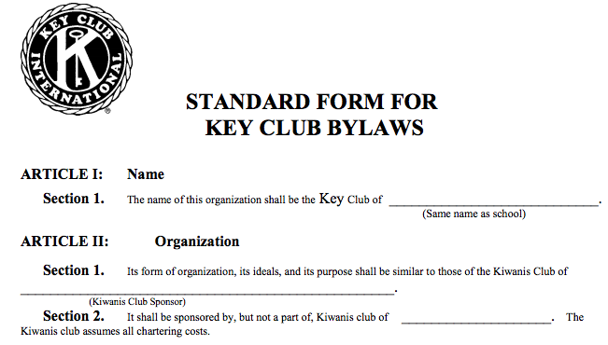
Standard Club Bylaws

Slide 5
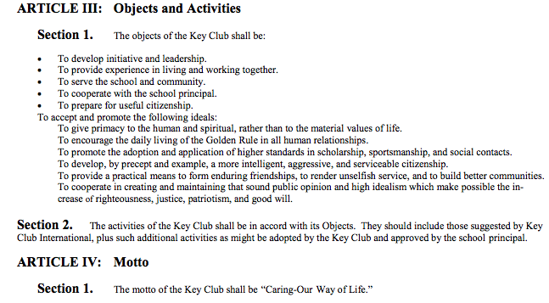
Standard Club Bylaws

Slide 6
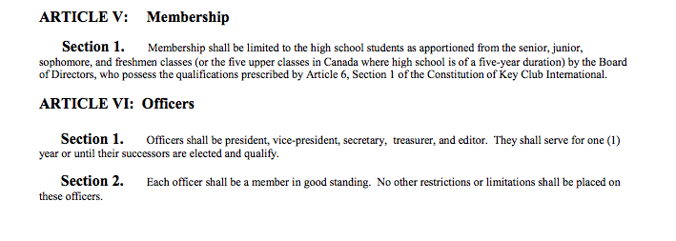
Standard Club Bylaws

Slide 7
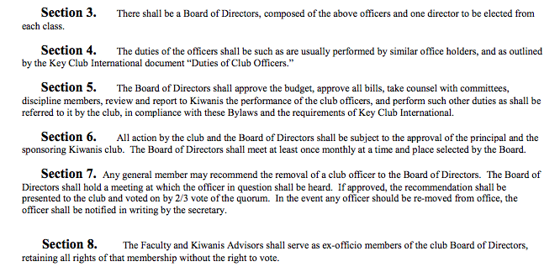
Standard Club Bylaws

Slide 8
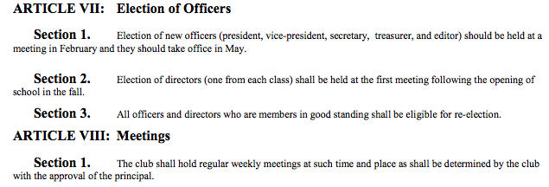
Standard Club Bylaws

Slide 9
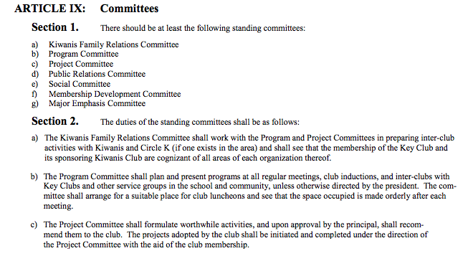
Standard Club Bylaws

Slide 10
Standard Club Bylaws

Slide 11
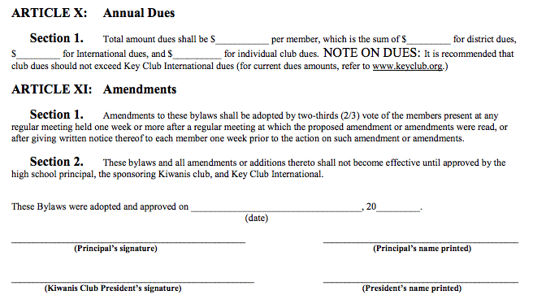
Standard Club Bylaws

Slide 12
Edits and Implementations
Officer Tasks/Duties
Different roles that come with the position depending on what the club requires
Extended Board
Social Media Coordinator
Fundraising Coordinators
etc.

Slide 13
Edits and Implementations (cont.)
Elections & Graduation Requirements
Must be a member in good standings
50 hours = medallion (example)
75 hours = stole (example)
Amendments
To amend

Slide 14
Edits and Implementations (cont.)
Due Process
Implement the removal process of an officer.
Annual Dues
Club can pick a certain day to always collect dues on

Slide 15
Questions?
Comments?
Concerns?

Slide 16
Acknowledgements
The CNH Key Club District would like to acknowledge the following individuals who have contributed to this presentation over the years.
Kai Catarata, Policy, International Business, and Elections Committee Chair, 2017-2018
Phuonguyen Rita Nguyen , Policy, International Business, and Elections Committee Chair, 2018-2019
Christopher Kao, Membership Development & Education Committee Chair, 2018-2019
Daniel Chong, Membership Development & Education Committee Chair, 2019-2020

