Slide 1
SERVICE
Presented by:
Erinn Wong
District Governor

Slide 2
WHY DO YOU LOVE SERVICE?
IT MAKES ME FEEL GOOD
I made an impact
It’s a thrill to organize
OH SO GOOD
A BIG ONE
LIKE A BOSS

Slide 3
SOME TYPES OF SERVICE
LABOR
What a workout.
Repetitive
Nice once in a while
$$$
Empowering
Motivating
Worthwhile
I want to do that again.
Socializing
Passion for a certain cause
KA-CHING
DEEP

Slide 4
LETS FACE THE PROBLEM
Why aren’t members performing service?
How do we get members more involved?
How much do I serve my
community?

Slide 5
SERVICE HOURS
COUNT THEM UP
WHO CARES?
Add them into your Monthly Report Form
See the growth
Document the service
For memory
Awards at DCON
Why count service?
Service for the good of it, not for hours.
Should a good deed even be counted?

Slide 6
MEANINGFUL SERVICE
Transportation System
Recognition
Substance
Variety
The people

Slide 7
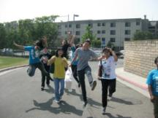
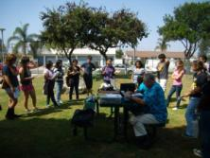
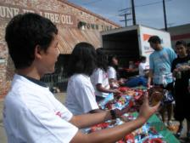

DURING SERVICE
Say a hi/hello/hey/yo
Do it together
GO INCLUSIVENESS
Document the efforts
Take pictures
Ask questions as the organizer.
SMILE!

Slide 8
QUESTIONS CONTINUED
Where does our service stop? If so, when?
How much do I love service?
What is the definition of service?

Slide 9
AT THE END OF SERVICE
Say your goodbyes.
Post the pictures
Restart
CONTINUE

Slide 10
THE PLANNING PROCESS
Plan
Survey the members
Advertise
Don’t procrastinate
Think…should this be a recurring project?

Slide 11
SERVICE PLANNING
BEE CREATIVE
Don’t do the generic carwash or charity walk.

Slide 12
FINDING SERVICE
If you’re having trouble thinking of a service project, here are some websites that can help get those creative juices flowing.
volunteercenter.org
volunteermatch.org
dosomething.org

Slide 13
THERE IS NO END
TO SERVICE

Slide 15
C N H K E Y C L U B
Training Conferences &
Leadership Workshops
Presented by:
The 2011-12 Executive Team

Slide 16

What are Training Conferences?
Officer Training Conference.
Region Training Conference.
Focuses on multiple areas
  i.e. different workshops at the same time
A taste of everything.
Choice.

Slide 17

What are Leadership Workshops?
Attendees at DCM.
Specific topics.
Helpful.
Informational.
Awe-inspiring.
Interesting.
General.
Food for thought.

Slide 18
The Right Time...Leadership Workshops
Hold during the DCM.
Choose topics that pertain to events
  i.e. Fundraising Tips for PTP in August
Consistency & Frequency.
Ask for opinions.
Think…what would the members benefit from?

Slide 19
Topic Ideas
Fundraising
How to Find Service Projects
Time Management
Leadership Skills
CNH Key Club 101
Key Club International 101
What are Club Bylaws?
The Kiwanis Family
Awards – How to Apply
Public Speaking
District Convention 101
The list goes on and on…

Slide 20

Topic Ideas (cont.)
Let’s Brainstorm!

Slide 21
Outstanding Members…They’re EVERYWHERE
Is someone an expert on a certain topic in your division?
Has someone done an exceptional job with fundraising?
ASK THEM TO HOST A WORKSHOP.

Slide 22
You truly become a great leader when...
You delegate work!
You’re not alone!
People will get bored of hearing your voice all of the time.
Others can benefit from their work.

Slide 23

Who to Ask?
Officers.
Members.
Kiwanians.
Advisors.
Special Guests.
Who would do an exceptional job?

Slide 24

Planning
Ask at least a MONTH in advance.
Give them due dates.
Give them specifics.
  Time
  Topic
  Audience
Brainstorm.
Bee supportive and thankful.
Provide them a memento
  i.e. Certification of Appreciation

Slide 25
Questions?
Ask away!

Slide 27
BEElieve – the Magic of Service
DCON ‘12 Theme Implementation & Promotion

Slide 28
District Convention Theme
Theme:
“BEElieve – the Magic of Service”

Slide 29
The Embodiment of the DCON ‘12 Theme
The feeling of knowing the impact of your service when you’re able to look back at a day of volunteering at the local hospital, the joy of serving alongside both old and new friends you’ve never met, the smile on a child’s face after reading to him or her in a public library – that is the feeling that we BEElieve in. That familiar, warm, fuzzy feeling is part of magic that comes from SERVICE, the cornerstone of our organization.

Slide 30
Theme Implementation
Apply the theme, “BEElieve – the Magic of Service” at your DCMs, OTCs, RTCs, and division events

Slide 31
OTC/RTC Implementation
Your OTC/RTC theme may be related to something MAGICAL!
Workshop titles and food may relate to the theme, and decorating your venue makes it all the more fun!

Slide 32
Theme Implementation at DCON
Decorate ballroom with twinkling lights above in ceiling of ballroom
Magical Music that will motivate members to reach their potential as community servers and leaders
Create large posters and banners for ways to promote service
Create inspiration by showing pictures of various service projects

Slide 33
Possible Music During DCON
Journey—“Don’t Stop Believing”
B.o.B— “I’ve Got the Magic in Me”
Michael Jackson—“Heal the World”
Katy Perry—“Firework”
U2—“It’s a Beautiful Day” “One”
Katrina and the Waves—“Walking on Sunshine”
“What a Wonderful World”
“Somewhere Over the Rainbow”
“Jai Ho” (Slumdog Millionaire)
James Brown— “I Feel Good”
Queen— “We Will Rock You”
Aerosmith— “Dream On”

Slide 34
Yearly Implementation
Including links to the DCON webpage on the CyberKey into your newsletters throughout the year
Using the theme throughout your socials, meetings, agendas, etc.
Using and spreading the logo all over your work and the District

Slide 35

BRAINSTORM SESSION!

Slide 36
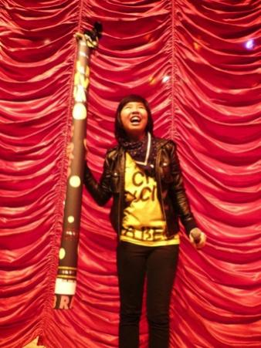
How NOT to Promote DCON
YO PEEPS, IF YOU’RE NOT IN KEY CLUB, YOU CAN STILL CRASH THE DISTRICT CONVENTION AND CHILL WITH US!

Slide 37
How NOT to Promote DCON
YO PEEPS, REMEMBER TO BRING YOUR DIVISION SPIRIT TO DCON!

Slide 38
How NOT to Promote DCON
YO PEEPS, COME TO DCON TO GET CRAZY AT GOVERNOR’S BALL! JUST STAY IN YOUR ROOM UNTIL THEN!

Slide 39
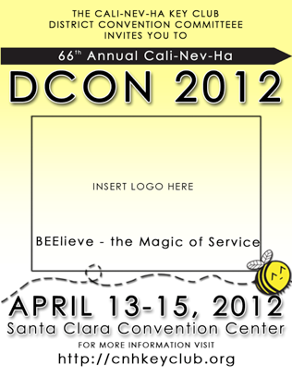
Ways to Promote DCON
Flyers
  Contain all the necessary resources for registration information, the dates, and etc.
  Easily accessible and they can be posted all around the internet.
  Facebook Profile pictures with DCON Information

Slide 40

Ways to Promote DCON
PowerPoint Presentations
  Promotional PowerPoints that can be distributed to all of the district.
  Lieutenant Governors can use material for RTCs or DCMs
  Presentation will include the convention activities and the registration process

Slide 41
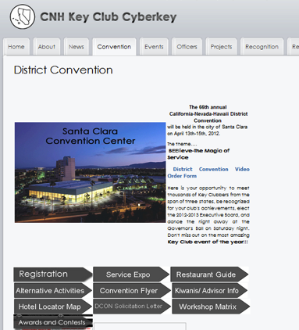
Ways to Promote DCON
Enhanced DCON Page on the CyberKey
  Add some magic to the current page to appeal to members.
  On this page, we can also post previews on the website, such as entertainers or activities.
  We will collaborate with Tech Editor Elijah on how to enhance the page

Slide 42
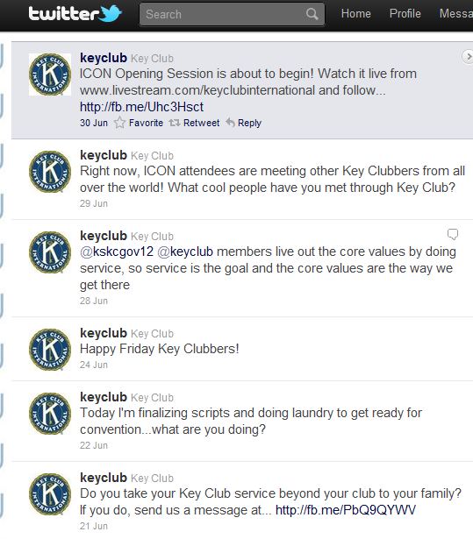
Ways to Promote DCON
Twitter
  Have a Twitter account for DCON updates for members
  Utilize “hashtag” system in which users can promote DCON. (ex. #DCON12 or #CNH12)
  Used for ICON 2011 using the #PHX11 hashtag
  We can see what members are saying about DCON

Slide 43
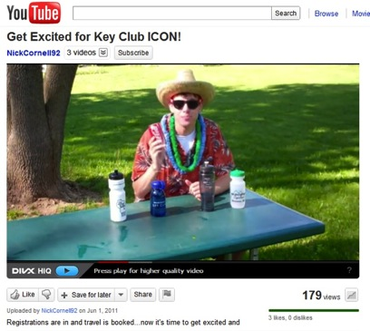
Ways to Promote DCON
  Videos
    We are exploring the possibility of various other videos to promote convention.

Slide 44

PLEASE REMEMBER:
We can explore the use of social media only to promote DCON
Key Club business is not to be conducted on social media – announcements only.

Slide 45
BEElieve – the Magic of Service
QUESTIONS, COMMENTS, CONCERNS, SUGGESTIONS?
Go for it!
Philip Nguyen and Nick Sianipar

Slide 47


EFFECTIVE EVENT PLANNING
Presented by:
Erinn Wong
District Governor

Slide 48
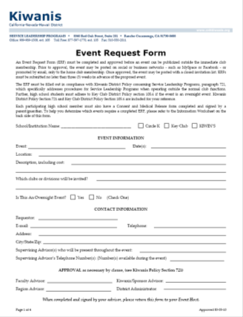
Event Request Form
Let’s review this.

Slide 49
Invent IT
Brainstorm possible event ideas.
  “The Sky is the Limit”
Don’t limit yourself to what has already been done.
Envision how it will look like; how it will run
Who/What/When/Where/Why…think of all components to the event!
Give yourself time.
Bee Creative

Slide 50
Do IT Right the first time…get help
Start WAY ahead of time.
Ask your advisors
Fill out the ERF
Research and develop it
Stop and ask yourself questions
Ask your peers
Announce it
Do NOT procrastinate!

Slide 51

ADvertise IT / FLYERS
It does not have to be complicated. It may be simple. Keep in mind that people will only look for a mere second. Do not spend so much time on one poster unless it will be seen by many people. Use advertising strategies.
Easy to read
Easy to produce
Cheap to make
Good impression
Not too wordy

Slide 52
ADvertise IT / SOCIAL MEDIA
What’s appropriate?
Create a private event on Facebook … AFTER all the details have been finalized.
Promote→ DON’T PLAN
Invite people only from the division you serve
Provide all information.

Slide 53
Tips for SUCCESS
Have the adults handle the money.
Don’t procrastinate!
Appoint task coordinators.
Thank everyone who helped in the process.
Events for a cause are more successful.
Bee personal.

Slide 54
Questions?
Go for it.

Slide 56
The Social Media
K E Y C L U B
Summer Board 2011
Presented by
District Technology Editor Elijah Kang
Division 35 East Lt. Governor John Yap
MRS
Information and resources provided by the
District Members Relations Committee 2011-2012

Slide 57

K E Y C L U B
What is social media?
Web-based and mobile technologies to turn communication into interactive dialogue or
“A group of Internet-based applications that build on the ideological and technological foundations of Web 2.0, which allows the creation and exchange of user-generated content.“
– Defined by
Andreas Kaplan and Michael Haenlein
MRS
Information and resources provided by the
District Members Relations Committee 2011-2012

Slide 58

K E Y C L U B
How it influences us
Freedom
Opinion
Communication
Express Yourself
Information
MRS
Information and resources provided by the
District Members Relations Committee 2011-2012

Slide 59
K E Y C L U B
Responsibility
Posting anything online is automatically archived and can get leaked
Posting online is like speaking in public
Your posts show your character
Photos mean more than just a thousand words
MRS
Information and resources provided by the
District Members Relations Committee 2011-2012

Slide 60
K E Y C L U B
What you CAN do
Express yourself in a positive manner
Update on events
Post family-friendly statuses
Share Interests
ADVERTISE!
MRS
Information and resources provided by the
District Members Relations Committee 2011-2012

Slide 61
K E Y C L U B
What NOT to do
*bleep* people are SO ANOOYING! THEY *bleep* AND *bleep*! EVERYDAY THEY *bleep* AND THE WAY THEY TALK IS SO *bleep* ANNOYING! OH MY **bleeeeeeeeeep**
Rant
Cyber Bully
Gossip
Discriminate
Post inappropriate content
Say something that may
offend others
MRS
Information and resources provided by the
District Members Relations Committee 2011-2012

Slide 62
K E Y C L U B
Summer Board 2011
Questions?
Elijah Kang
cnhkc.dte1112@gmail.com
(818) 518-4393
John Yap
d35e.cnhkc.ltg@gmail.com
(626) 643-9922
MRS
Information and resources provided by the
District Members Relations Committee 2011-2012

Slide 64
Webinars
C N H K E Y C L U B
Presented by
Governor Erinn Wong
and
Zack Dameron, D18
MRS
Information and resources provided by the
District Members Relations Committee 2011-2012

Slide 65

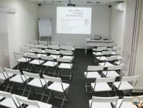
What is a webinar???
C N H K E Y C L U B
Web Seminar
It is an interactive, speaker-led learning session that is delivered over the internet.

Slide 66










C N H K E Y C L U B
 | Collaboration | # of Attendees | Purpose
Online Meeting | Highly interactive Multi-way communication | 2-20 | Remote Business meetings ****** Staff , client or board meeting
Webinar | Limited 2-way communication | 2-500 | Remote presentation ****** Conference session or training
Webcast | 1-way communication | 2-Thousands | Remote broadcast of information to large audiences ***** Keynote

Slide 67
Advantages
C N H K E Y C L U B
You can record a meeting and play it at a later time.
Not dependent on the location of the participants.
Can chat with participants without disturbing the meeting.
Allow participants to upload documents or presentations to be shared during the meeting

Slide 68

C N H K E Y C L U B
Disadvantages
Variation of learning styles
No direct interaction
Speaker cannot tell if audience is listening

Slide 69

C N H K E Y C L U B
What do you and your viewers need?
Computer
Phone
Internet
Speakers

Slide 70

C N H K E Y C L U B
Features
Recording
Captioning
Virtual Whiteboard
Screen Sharing
Pooling
File Transfer
Group Collaboration

Slide 71

C N H K E Y C L U B
What program do I use?
http://www.ilinc.com
1. Register
2. Watch Tutorials
3. Get Started!!!

Slide 72
C N H K E Y C L U B
Questions???
Comments???
Concerns???

Slide 74

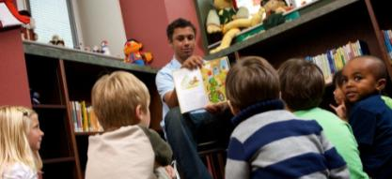


Effective Workshops
Cali-Nev-Ha Key Club
Updated Summer 2011
Presented By: Lydia Thung and Byran Yang
MRS
Information and resources provided by the District Members Relations Committee 2011-2012

Slide 75
Cali-Nev-Ha Key Club
Workshop Pre-planning
Before beginning your PowerPoint presentation, think about these questions
  Who is your audience?
  What is the purpose of your workshop?
  How will you keep your audience engaged in the workshop?
  How long should your workshop be?
“Speakers who talk about what life has taught them never fail to keep the attention of their listeners.” –Dale Carnegie

Slide 76
Cali-Nev-Ha Key Club
Look into your workshop topic
  Research & familiarize yourself with all necessary information
Know what you are talking about
Make sure your information is accurate!
Officer workshops
  Have an officer present the workshop because they have first hand experience
“Speakers who talk about what life has taught them never fail to keep the attention of their listeners.” –Dale Carnegie

Slide 77
Cali-Nev-Ha Key Club
Workshop Planning
Create an outline of what you are going to discuss
Create a PowerPoint with information in your outline
  PowerPoint should be straight-forward and to the point
  PPT should be vague because you are the center of attention!
  Make your PPT appealing so it will catch your audiences’ attention
“Speakers who talk about what life has taught them never fail to keep the attention of their listeners.” –Dale Carnegie

Slide 78
Cali-Nev-Ha Key Club
Appearance
Dress “one up” from your audience
  If your audience is dressed casual then you should dress business casual or business professional
Have good posture
  Be very proper
Speak loud and clear
Make eye contact with your audience
If you don’t present yourself well then why should your audience pay attention to you?
“Speakers who talk about what life has taught them never fail to keep the attention of their listeners.” –Dale Carnegie

Slide 79
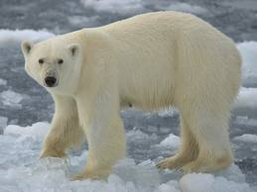
Cali-Nev-Ha Key Club
How much does this polar bear weigh?!
“Speakers who talk about what life has taught them never fail to keep the attention of their listeners.” –Dale Carnegie

Slide 80
Cali-Nev-Ha Key Club
Your Audience
Engage the audience
  By keeping the audience constantly on their feet, they will have a better time and learn more
Incorporate ice breakers, hand outs, random questioning, etc
  Hand outs – fill in the blanks keep the audience focused on the KEY points
  Random questioning – asking questions to members who aren’t paying attention will make them pay attention again
    You can also give out a reward to active listeners
“Speakers who talk about what life has taught them never fail to keep the attention of their listeners.” –Dale Carnegie

Slide 81

Cali-Nev-Ha Key Club
Ice Breakers
Ice Breakers are a fun way to ease tension between your audience and make a connection to your workshop topic
  There are numerous ice breakers for all different group sizes
  Types of ice breakers can range from silly individual games to group games
Getting your audience interested in playing an ice breaker may be hard so be enthusiastic!
After the ice breaker, explain the concept behind it to further expand your members’ knowledge on the topic
“Speakers who talk about what life has taught them never fail to keep the attention of their listeners.” –Dale Carnegie

Slide 82
Cali-Nev-Ha Key Club
Ice Breaker WARNING
Ice Breakers must have a purpose
Some find them a waste of time especially when more time is spent on the icebreaker then the actual workshop
Not every workshop needs a game or gimmick to introduce the topic…
  Look for a HOOK
  Sometimes a story, a mini quiz, a question with raise your hand responses lead the audience into the topic
Do not minimize the value of the workshop or the content
“Speakers who talk about what life has taught them never fail to keep the attention of their listeners.” –Dale Carnegie

Slide 83
Cali-Nev-Ha Key Club
Relating to the Audience
Add a personal experience (related to the topic)
  This will strengthen your reliability and authority
Ask the audience questions
  Have them share their stories
Call on a variety of people and make everyone feel important
“Speakers who talk about what life has taught them never fail to keep the attention of their listeners.” –Dale Carnegie

Slide 84
Cali-Nev-Ha Key Club
Questions? Comments?
Concerns?
Byran Yang
Division 41 South LTG
Email: d41s.cnhkc.ltg@gmail.com
Lydia Thung
Division 7 South LTG
Email: d07s.cnhkc.ltg@gmail.com
“Speakers who talk about what life has taught them never fail to keep the attention of their listeners.” –Dale Carnegie

Slide 86

MEMBERSHIP/DUES DRIVE
CNH KEY CLUB
Presented by District Treasurer
Christopher J. Van
Executive Committee, Cali-Nev-Ha District, Key Club International

Slide 87
It’s coming soon!
  That special magical time of the year between August and October when underclassmen and previously unengaged upperclassmen pour into the first club meeting to see what the fuss is all about. The beginning of the school year is a pivotal point in membership recruitment
Executive Committee, Cali-Nev-Ha District, Key Club International

Slide 88
It’s coming soon!
  WHAT IDEAS DO YOU HAVE TO ATTRACT NEW AND RETURNING MEMBERS?
Executive Committee, Cali-Nev-Ha District, Key Club International

Slide 89
Engaging Students
  #1 Question: Hey, what is Key Club?
  Key Club is an international, student-led organization providing its members with opportunities to perform service, build character, and develop leadership. We are caring and competent leaders transforming communities world-wide!
  Or….
Executive Committee, Cali-Nev-Ha District, Key Club International

Slide 90
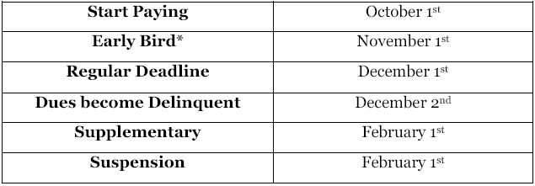
Dues Basics
  Dues can range between $11.00-$22.00
  ($6.50 to International, and $4.50 to CNH)
  Dates to Remember! (received by)
Dues Recognition
Executive Committee, Cali-Nev-Ha District, Key Club International

Slide 91
What’s Our Goal?
  44,000
Executive Committee, Cali-Nev-Ha District, Key Club International

Slide 92
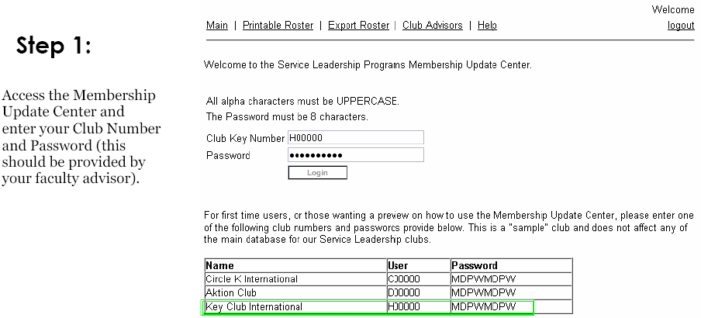
Membership Update Center
  http://soapmu.kiwanis.org
*New Club Key password is mailed to faculty advisor in September
Executive Committee, Cali-Nev-Ha District, Key Club International

Slide 93
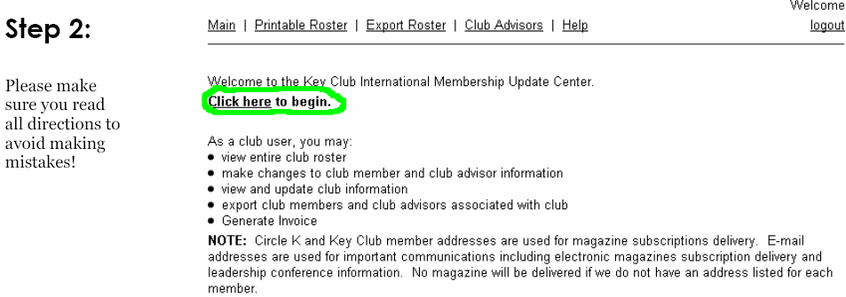
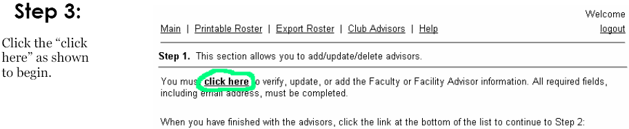
Begin!
Executive Committee, Cali-Nev-Ha District, Key Club International

Slide 94
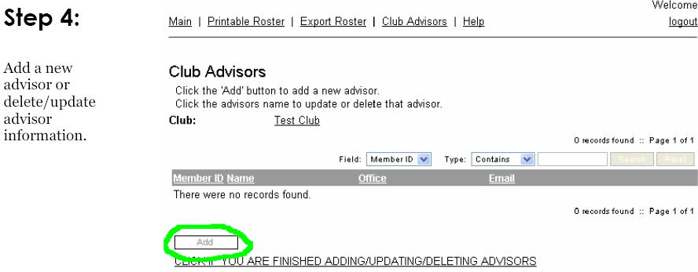
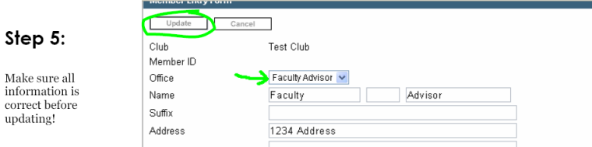
Updating Club Advisors
Executive Committee, Cali-Nev-Ha District, Key Club International

Slide 95
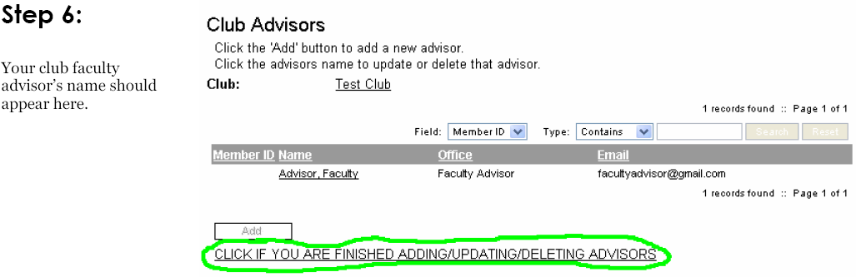
Updating Club Advisors
Executive Committee, Cali-Nev-Ha District, Key Club International

Slide 96
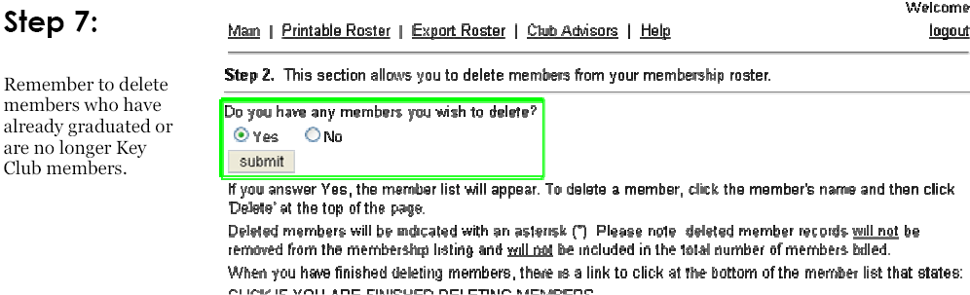
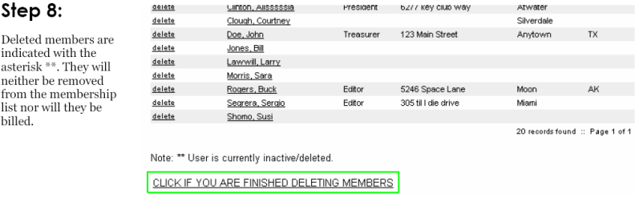
Deleting Members
Executive Committee, Cali-Nev-Ha District, Key Club International

Slide 97
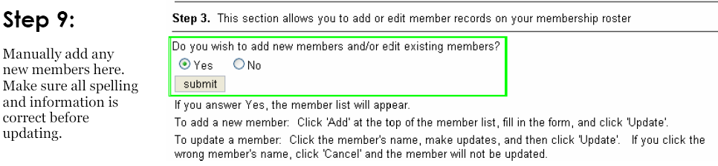
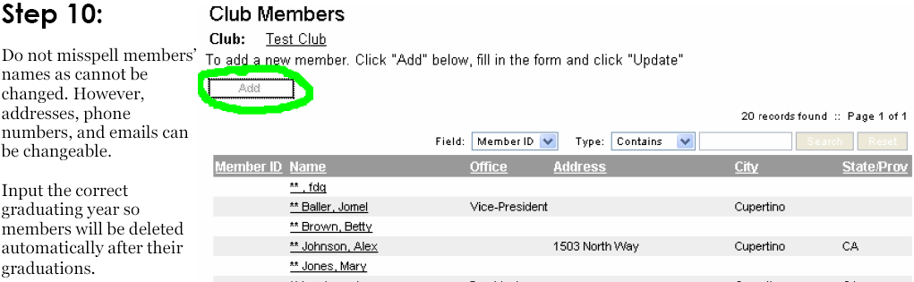
Adding/Editing Members
Executive Committee, Cali-Nev-Ha District, Key Club International

Slide 98
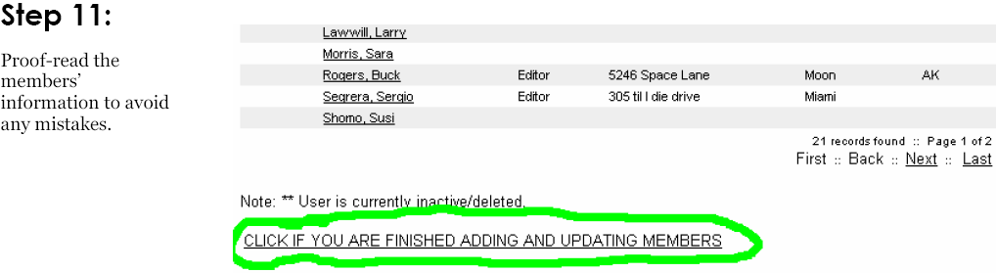
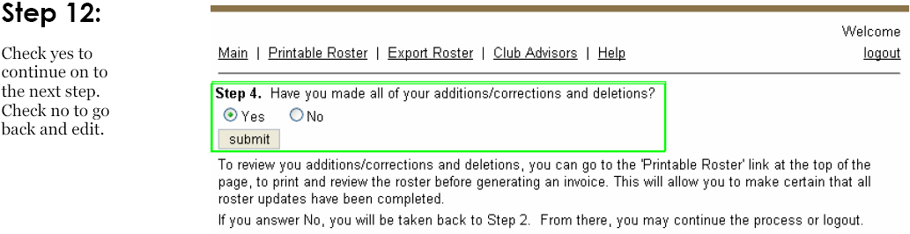
Adding/Editing Members
Executive Committee, Cali-Nev-Ha District, Key Club International

Slide 99
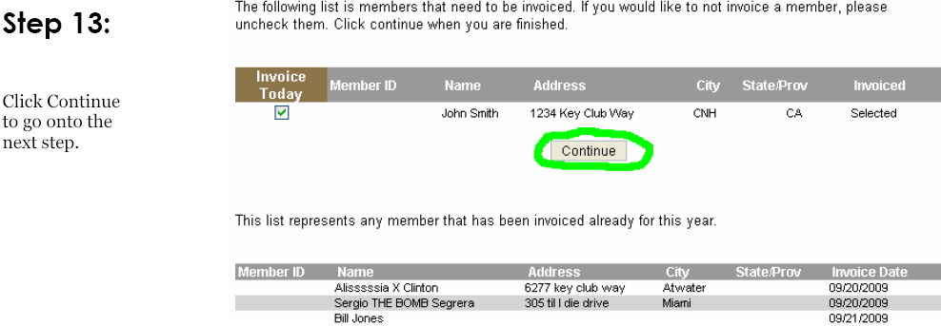
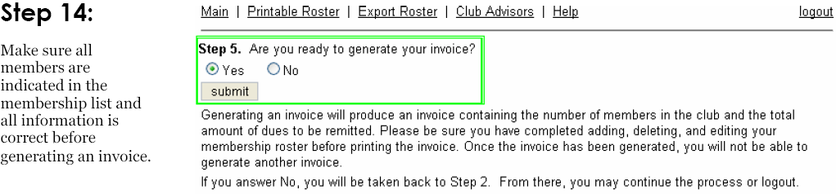
Generating an Invoice
Executive Committee, Cali-Nev-Ha District, Key Club International

Slide 100
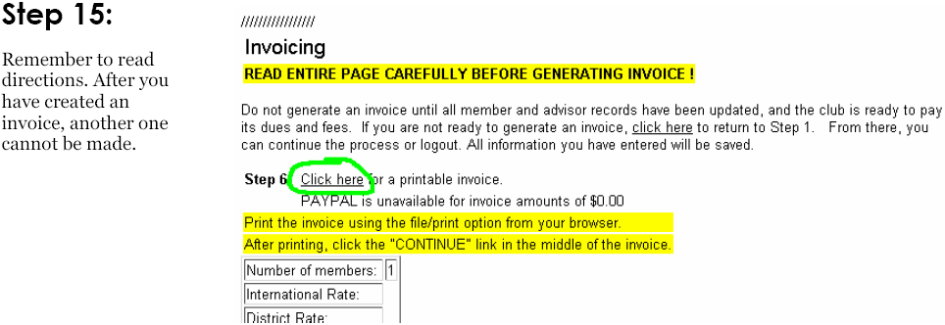
Generating an Invoice
Executive Committee, Cali-Nev-Ha District, Key Club International

Slide 101
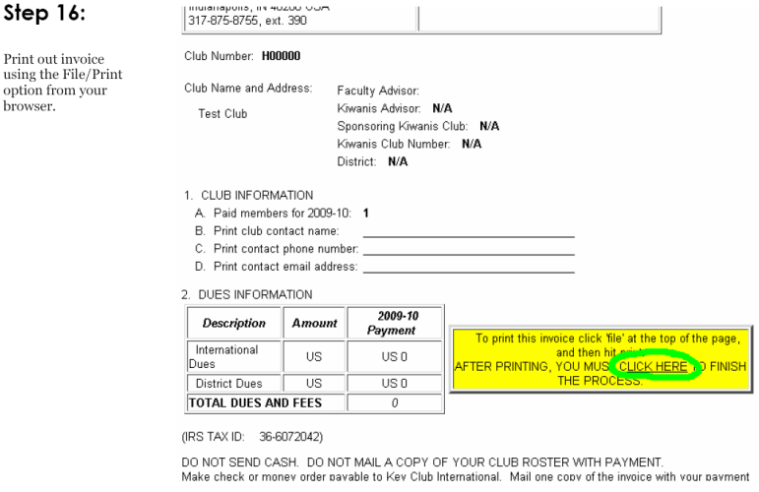
Printing an Invoice
Executive Committee, Cali-Nev-Ha District, Key Club International

Slide 102
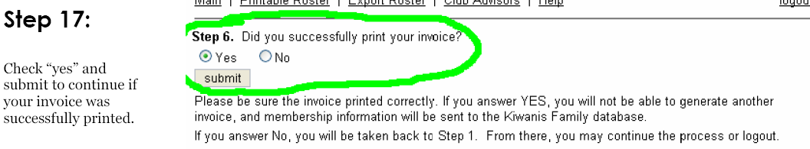
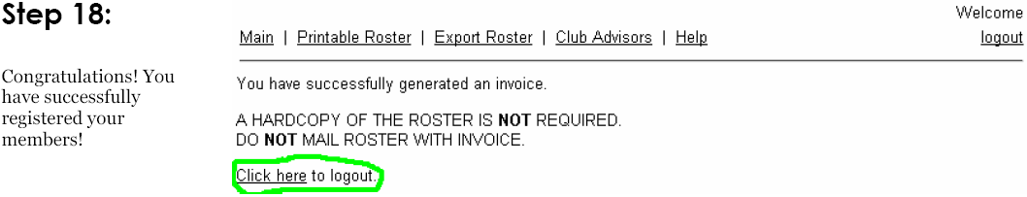
Finish!
Executive Committee, Cali-Nev-Ha District, Key Club International

Slide 103
Submission
  Send a copy of the printed invoice, along with a check payable to Key Club International to
  Key Club International
  PO Box 6069, Dept 123
  Indianapolis, IN 46206-6069
  (unless paying via PayPal, just mail the invoice)
Executive Committee, Cali-Nev-Ha District, Key Club International

Slide 104
General Questions
What happens if a club doesn’t pay dues on time?
Can we update more members throughout the year?
How should we collect membership dues?
When do membership cards come in?
How long do dues take to process?
Why should members pay dues?
Executive Committee, Cali-Nev-Ha District, Key Club International

Slide 105
Got Questions?
CNH KEY CLUB
I’m all ears! ☺
Christopher J. Van, District Treasurer
cnhkc.dt1112@gmail.com
Executive Committee, Cali-Nev-Ha District, Key Club International

Slide 107
Club Bylaws
Presented by
Miles Glick, Chair
Anika Dhamodharan, Lt. Governor

Slide 108
Objectives
Club bylaws and policies
  What are they?
  What are the advantages?
  Why are they useful?
Agreement To Serve Form
  What are they?
  What are the advantages?

Slide 109
Did you know?
Only a few of the 680 Key Clubs in CNH District have an effective, resourceful set of Standard Club Bylaws and Policies in use.

Slide 110
Club Bylaws and Policies
A club’s bylaws and policies are the guidelines of the club’s operating procedures.

Slide 111
Advantages
Provides infrastructure and guidance for club activities
  Elections
  Board Discipline
  Event planning
Ensures an organized and fair way of operating the Key Club
Rules are subject to change
  A club chooses to change their bylaws to represent the members best interests.

Slide 112
What Do Club Bylaws Contain That Is Useful?
Regular Club bylaws contain the following…
  Club Service-leadership Objectives or Goals of the Club
  Club Officer Duties and Club Election Procedures
  Club Committees and Their Duties (optional)
  Amendment Procedures

Slide 113
More Information
Requirements to KCI and CNH District Bylaws/Policies are available at
Cyberkey > Resources Tab > Policy and Forms
or
http://cnhkeyclub.org/resources/policy-and-forms

Slide 114
Where Can I Obtain A Copy Of My Club’s Bylaws?
Your school’s ASB office
or
If they do not have a copy of your club’s bylaws: call 1-800-KIWANIS
  Be sure to have your Club ID Number
  (it should start with an H)

Slide 115
Club Officer
Agreement To Serve Form
(Service Agreement)

Slide 116
What Is An Agreement To Serve Form?
A Service Agreement
Commitment to Fulfill Identified Duties
Signed & Submitted before running for office.
More Information:
Cyberkey > Resources Tab > Policy and Forms
or
http://cnhkeyclub.org/resources/policy-and-forms

Slide 117
Advantages
Strengthens club officer commitment
Provides a source for accountability
Provides clear expectations and a foundation for interventions
Provides guidelines for effective leadership development

Slide 118
Leadership Development is the Goal
The Agreement to Serve Form is a guideline for officers to follow
Spend time educating new officers on their duties and give them time to grow.
Encourage attendance at Officer’s Training Conference by potential & current officers.

Slide 119
Questions
Are Agreement To Serve Forms Required?
  No, but they are strongly recommended
Can our club change something on the Agreement To Serve Form?
  Yes, you can change the guidelines to suite your club’s specific needs.

Slide 120
How to Implement The Agreement To Serve Annually
Incorporate the Agreement To Serve Form in your club’s bylaws
Add the following clause
    “All club officer candidates must sign the club officer agreement to serve form at least a week prior to running for office. Failure to do so will invalidate the candidates bid.”
Bylaws must be approved by the general membership as stated in the club bylaws.

Slide 121
How to remove a Club Officer?
Board removal is the absolute last option! Key Club is about leadership development!
Confront the officer several times, with the club advisor’s supervision, to educate and resolve the issue.
Discuss board removal as a possibility with your club’s board.
Consult the club’s bylaws for the proper procedure.
**The procedures MUST be written in the Club’s bylaws to remove anyone.

Slide 122
Questions?
Comment?
Concerns?

Slide 123
Contact Information
Miles Glick
Policies, International & Elections Committee Chair
cnhkc.pie1112@gmail.com
Anika Dhamodharan
Policies Subcommittee Chair
d34s.cnhkc.ltg@gmail.com
Join the policy reflector group at:
http://groups.google.com/group/cnh-kc-policy?hl=en

Slide 125

The Kiwanis Family Overview
CALI-NEV-HA K E Y C L U B
By D13N Julie Nguyen
&
D30N Akash Patel
Kiwanis Family and Foundation
|
KFF
Kiwanis Family and Foundation Committee
California Nevada Hawaii District

Slide 126

Table of Contents
CALI-NEV-HA K E Y C L U B
K-kids
  Terrific Kids
  BUG
Builders Club
Key Leader
KIWIN’S
Circle K
Aktion Club
Kiwanis International
  Kiwanis One-Day
KFF
|
Kiwanis Family and Foundation Committee
California Nevada Hawaii District

Slide 127

K- Kids
CALI-NEV-HA K E Y C L U B
Elementary school student led service organization.
Motto: “We Build”
Objectives :
  To develop leadership potential.
  To foster and development of strong moral character.
  To provide opportunities to working together in service to school and community.
KFF
|
Kiwanis Family and Foundation Committee
California Nevada Hawaii District

Slide 128

*Terrific Kids*
CALI-NEV-HA K E Y C L U B
Student recognition program.
Promotes character development,
self esteem, and perseverance.
Students work to improve behavior,
peer relationships, attendance, or schoolwork.
Elementary school age children ages 6-12.
KFF
|
Kiwanis Family and Foundation Committee
California Nevada Hawaii District

Slide 129

*Bring Up Grades (BUG)*
CALI-NEV-HA K E Y C L U B
Program designed to recognize students who raise their grades to an acceptable range.
Recognition includes schools BUG Honor Roll; a themed-food party and etc.
Elementary school age children
ages 6-12.
KFF
|
Kiwanis Family and Foundation Committee
California Nevada Hawaii District

Slide 130

Builders Club
CALI-NEV-HA K E Y C L U B
A “student-led” community service organization
that operates under school regulations
Motto: “Building Leaders.”
Vision: To develop competent, capable,
caring leaders through service.
Mission: To provide members with opportunities to perform service, build character, and develop leadership.
KFF
|
Kiwanis Family and Foundation Committee
California Nevada Hawaii District

Slide 131
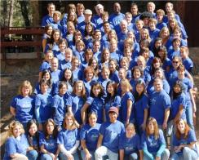
Key Leader
CALI-NEV-HA K E Y C L U B
Kiwanis International’s leadership education program
for students.
Mission: to provide a life-changing experience that inspires young people to achieve their personal best through service leadership.
Places over a course of 3 days for high
school students ages 14-18.
KFF
|
Kiwanis Family and Foundation Committee
California Nevada Hawaii District

Slide 132

KIWIN’S
CALI-NEV-HA K E Y C L U B
32nd District of Key Club International (KCI). Located in California, Nevada, and Hawaii.
Over 50 clubs with approximately
2,500 members.
KIWIN’S divisions are coral, crystal, diamond,
emerald, goldstone, jade, jet, ruby, sapphire,
topaz, and turquoise.
The District Board consists of 12 Lt. Governors.
KFF
|
Kiwanis Family and Foundation Committee
California Nevada Hawaii District

Slide 133

Circle K
CALI-NEV-HA K E Y C L U B
Circle K International (CKI) is the premiere university service organization in the world sponsored by Kiwanis
International.
450 colleges in 17 nations.
College and university students.
KFF
|
Kiwanis Family and Foundation Committee
California Nevada Hawaii District

Slide 134

Aktion Club
CALI-NEV-HA K E Y C L U B
For adults who live with a disability.
Mission: develop initiative and
leadership skills; serve their community;
integrate into society, dignity and value
of citizens living with disabilities.
Objects: Primacy to the human and spiritual;
encourage living of the Golden Rule; promote higher business, professional, and
KFF
|
Kiwanis Family and Foundation Committee
California Nevada Hawaii District

Slide 135

Kiwanis International
CALI-NEV-HA K E Y C L U B
Organization of members of every age
who are dedicated to changing the world,
one child and one community at a time.
Headquartered in Indianapolis, Indiana.
Made up of approximately 8,600 clubs in 96 countries with over 586,000 adult members.
Sponsors the other smaller branches of the Kiwanis Family.
KFF
|
Kiwanis Family and Foundation Committee
California Nevada Hawaii District

Slide 136

Kiwanis One Day
CALI-NEV-HA K E Y C L U B
The Kiwanis Service Initiative is observed worldwide in April - Kiwanis One Day.
Every club is encouraged to join with every level of the Kiwanis Family.
Opportunity to showcase the Kiwanis family and our commitment to service in
the community.
KFF
|
Kiwanis Family and Foundation Committee
California Nevada Hawaii District

Slide 137
Thank You for Listening
CALI-NEV-HA K E Y C L U B
If you have any questions, comments, or concerns, feel free to contact us!
|
KFF
Kiwanis Family and Foundation Committee
California Nevada Hawaii District

Slide 139

Co-Sponsorships
CALI-NEV-HA K E Y C L U B
By Mark Ubongen and
D14/39 Cheyenne Cameron-Pruitt
Kiwanis Family and Foundation
KFF
|
Kiwanis Family and Foundation Committee
California Nevada Hawaii District

Slide 140



What is Co-Sponsorship?
CALI-NEV-HA K E Y C L U B
Co-Sponsorship is helping a Kiwanis Club in sponsoring another Kiwanis Sponsored Organization.
Key Clubs, at the high school level, can only co-sponsor an Aktion Club, Builder’s Club, or K-Kids.
There are a few steps needed to take when doing a co-sponsorship, and this presentation will teach you just that!
KFF
|
Kiwanis Family and Foundation Committee
California Nevada Hawaii District

Slide 141
Steps to Co-Sponsoring
CALI-NEV-HA K E Y C L U B
Find a Kiwanis Sponsor
  Usually, a Kiwanis Club sponsors an SLP club – offering both financial support and hands-on guidance. Your sponsor can help you outline an initial budget for expected expenses.
  Also, find a willing Kiwanis sponsor when first approaching your Kiwanis Club with this project.
KFF
|
Kiwanis Family and Foundation Committee
California Nevada Hawaii District

Slide 142
Steps to Co-Sponsoring
CALI-NEV-HA K E Y C L U B
2. Finding A Location
  Depending on the type of club you’re starting, your home site may be a school, community center or other facility.
  Where do you plan to do a co-sponsorship?
KFF
|
Kiwanis Family and Foundation Committee
California Nevada Hawaii District

Slide 143
Steps to Co-Sponsoring
CALI-NEV-HA K E Y C L U B
Ask Permission
  Before starting any business on private property, it is always important to ask the people responsible.
  Go to the school principal, administrator, or anyone who is in charge and propose the project being conducted.
KFF
|
Kiwanis Family and Foundation Committee
California Nevada Hawaii District

Slide 144
Steps to Co-Sponsoring
CALI-NEV-HA K E Y C L U B
4. Finding Advisors
  You’ll need an advisor from the location (faculty at a school, etc.) and a local Kiwanis Club who are willing to help the project.
  Both bring different expertise to the table to help guide the club.
KFF
|
Kiwanis Family and Foundation Committee
California Nevada Hawaii District

Slide 145
Steps to Co-Sponsoring
CALI-NEV-HA K E Y C L U B
5. Recruitment
  Once it has proper approval, start recruitment of your club!
  Have a meeting with the administrators and the Kiwanis Advisor on possible dates you can recruit for potential members.
  Do recruiting by hosting a booth at an orientation or open house. (if at a school)
  Make fliers that explain the club, posters to attract members, and a sign up sheet for any people who are interested in possibly joining the club.
KFF
|
Kiwanis Family and Foundation Committee
California Nevada Hawaii District

Slide 146
Steps to Co-Sponsoring
CALI-NEV-HA K E Y C L U B
Beginning the Club
  Run the first few meetings and make them fun!
  Introduce them to what Builders/K-Kids Club is and the sole purpose why one was started.
  Find people willing to lead and apply to become officers of the club.
  Have people help you run interviews, review applications for officer positions, etc.
KFF
|
Kiwanis Family and Foundation Committee
California Nevada Hawaii District

Slide 147
Steps to Co-Sponsoring
CALI-NEV-HA K E Y C L U B
Get Organized
  Prepare paperwork and report your club to the Kiwanis International Office.
  Help elect and train officers and directors.
  Help plan your club’s meeting schedule.
KFF
|
Kiwanis Family and Foundation Committee
California Nevada Hawaii District

Slide 148
Steps to Co-Sponsoring
CALI-NEV-HA K E Y C L U B
Chartering
  Once the club is up and running, it’s time to make it official!
  Help gather funds from the Kiwanis Club as well as the club to charter the new club!
  Hold a Chartering Ceremony where the club receives a Kiwanis Family banner, gavel, and bell.
KFF
|
Kiwanis Family and Foundation Committee
California Nevada Hawaii District

Slide 149
Reminders!
CALI-NEV-HA K E Y C L U B
After completing these steps, your new co-sponsored club should be up and running in no time!
Make sure to help in training officers, budgeting, and setting goals.
Get your home club to support you in this project! Your club can also help the Kiwanis with funds.
Attend board meetings to provide your personal input, almost as if you were an advisor.
It’s important to keep them active, so have interclub events with them! Invite them to events you think might be holding with your clubs and get them involved!
KFF
|
Kiwanis Family and Foundation Committee
California Nevada Hawaii District

Slide 150
Resources
CALI-NEV-HA K E Y C L U B
Kiwanis Chartering Toolkit
  http://www.kiwanisone.org/Pages/Resources/default.aspx?PageID=372
KFF
|
Kiwanis Family and Foundation Committee
California Nevada Hawaii District

Slide 151
Thanks for Listening!
CALI-NEV-HA K E Y C L U B
Questions? Comments? Concerns?
We’d love to hear your input!
Thank you for your interest in expanding
our Kiwanis Family! ☺
KFF
|
Kiwanis Family and Foundation Committee
California Nevada Hawaii District

